Slide 1
Chapter 12: File System Implementation

Slide 2

Contiguous Allocation
Mapping from logical to physical
Q
LA/512
R
  Block to be accessed = Q + starting address
  Displacement into block = R

Slide 3
Extent-Based Systems
Many newer file systems (i.e., Veritas File System) use a modified contiguous allocation scheme
Extent-based file systems allocate disk blocks in extents
An extent is a contiguous block of disks
  Extents are allocated for file allocation
  A file consists of one or more extents

Slide 4
Allocation Methods - Linked
Linked allocation – each file a linked list of blocks
  File ends at nil pointer
  No external fragmentation
  Each block contains pointer to next block
  No compaction, external fragmentation
  Free space management system called when new block needed
  Improve efficiency by clustering blocks into groups but increases internal fragmentation
  Reliability can be a problem
  Locating a block can take many I/Os and disk seeks

Slide 5

Linked Free Space List on Disk
Linked list (free list)
  Cannot get contiguous space easily
  No waste of space
  No need to traverse the entire list (if # free blocks recorded)

Slide 6
Allocation Methods – Linked (Cont.)
FAT (File Allocation Table) variation
  Beginning of volume has table, indexed by block number
  Much like a linked list, but faster on disk and cacheable
  New block allocation simple

Slide 7

Linked Allocation

Slide 8

File-Allocation Table

Slide 9

Example of Indexed Allocation

Slide 10
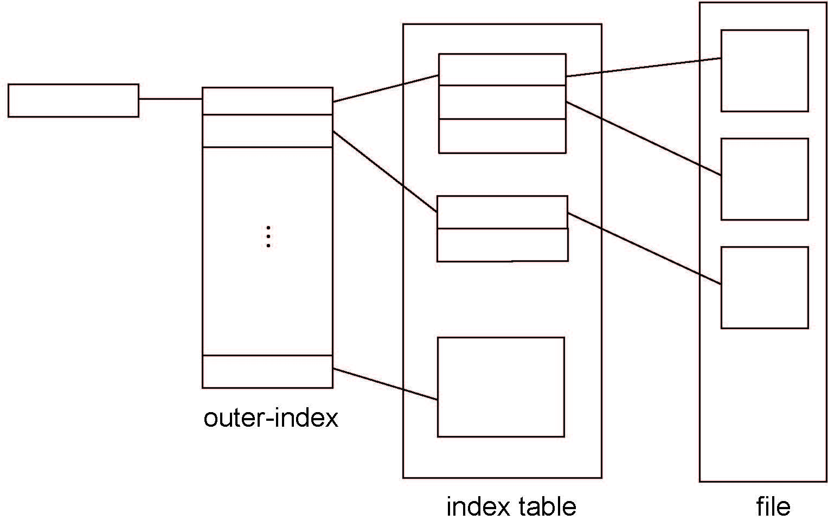
Indexed Allocation – Mapping (Cont.)

Slide 11

Combined Scheme: UNIX UFS
4K bytes per block, 32-bit addresses
More index blocks than can be addressed with 32-bit file pointer

Slide 12
Free-Space Management
File system maintains free-space list to track available blocks/clusters
  (Using term “block” for simplicity)
Bit vector or bit map (n blocks)
0
1
2
n-1
…
1 ⇒ block[i] free
0 ⇒ block[i] occupied
bit[i] =

Block number calculation
(number of bits per word) *
(number of 0-value words) +
offset of first 1 bit
CPUs have instructions to return offset within word of first “1” bit

Slide 13
Free-Space Management (Cont.)
Bit map requires extra space
  Example:
block size = 4KB = 2¹² bytes
disk size = 2⁴⁰ bytes (1 terabyte)
n = 2⁴⁰/2¹² = 2²⁸ bits (or 32MB)
if clusters of 4 blocks -> 8MB of memory
Easy to get contiguous files

